Slide 1
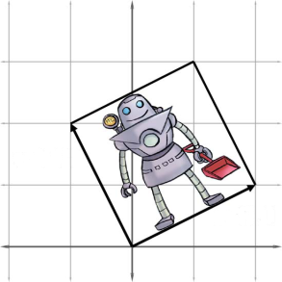
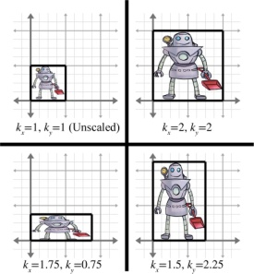
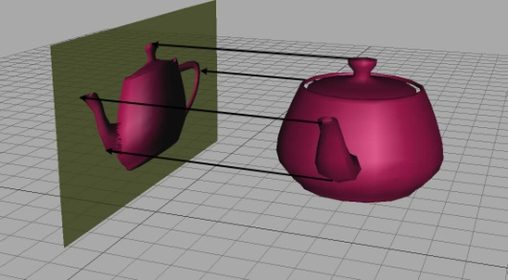
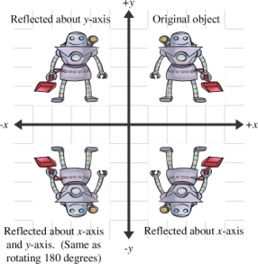
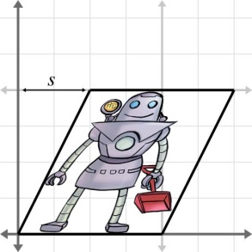
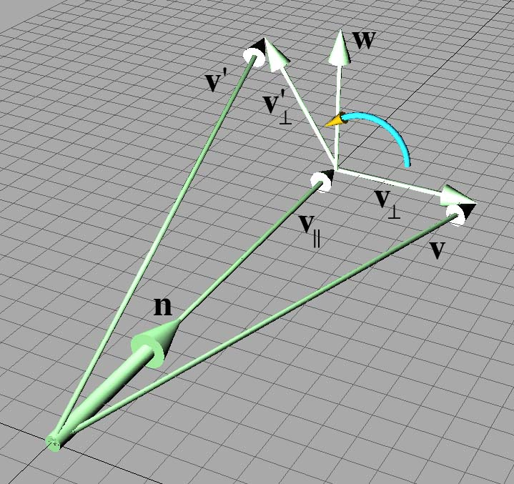
Chapter 5 Matrices & Linear Transforms
Fletcher Dunn
Valve Software
Ian Parberry
University of North Texas
3D Math Primer for Graphics & Game Development

Slide 2
What You’ll See in This Chapter
This chapter is concerned with expressing linear transformations in 3D using 3×3 matrices. It is divided roughly into two parts.
In the first part, Sections 5.1-5.5, we take the basic tools from previous chapters to derive matrices for primitive linear transformations of rotation, scaling, orthographic projection, reflection, and shearing.
The second part of this chapter returns to general principles of transformations.
Section 5.6 shows how a sequence of primitive transformations may be combined using matrix multiplication to form a more complicated transformation.
Section 5.7 discusses various interesting categories of transformations, including linear, affine, invertible, angle-preserving, orthogonal, and rigid-body transforms.

Slide 3
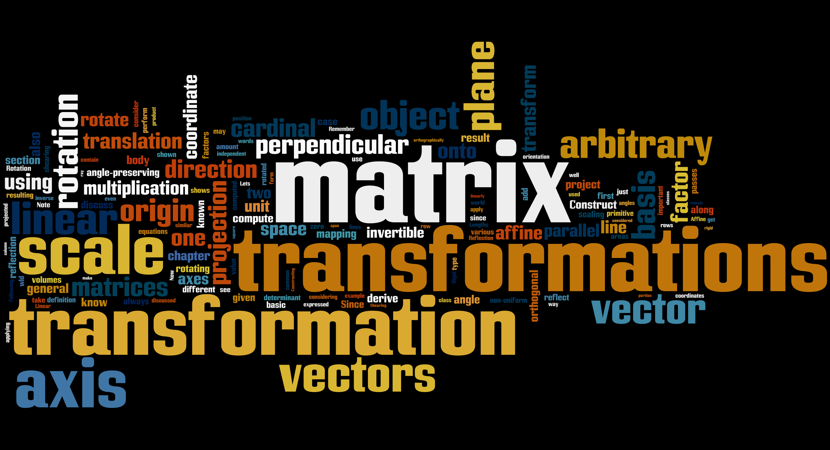
Word Cloud

Slide 4
Section 5.1: Rotation

Slide 5
Reminder: Visualize The Matrix (Chapter 4)
Each row of a matrix is a basis vector after transformation.
Given an arbitrary matrix, visualize the transformation by its effect on the standard basis vectors – the rows of the matrix.
Given an arbitrary linear transformation, create the matrix by visualizing what it does to the standard basis vectors and using that for the rows of the matrix.

Slide 6
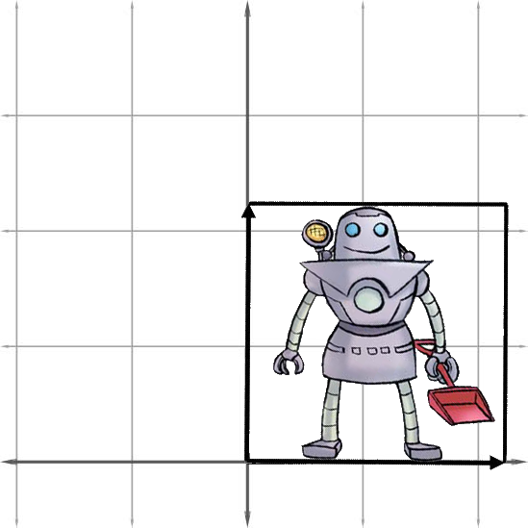

2D Rotation Around Point
Before
After

Slide 7
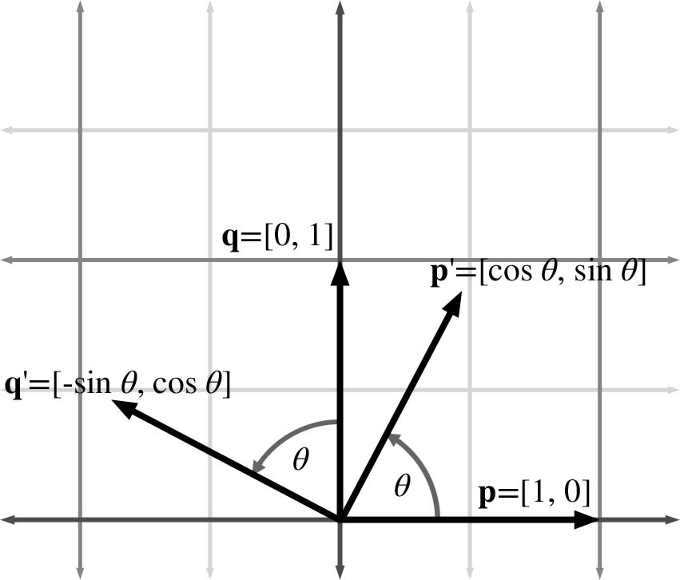
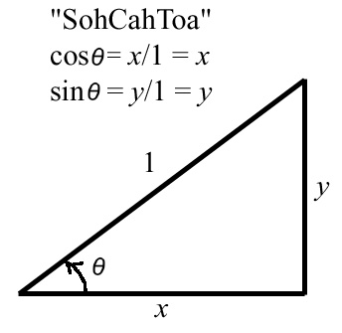
It’s All About Rotating Basis Vectors!

Slide 8
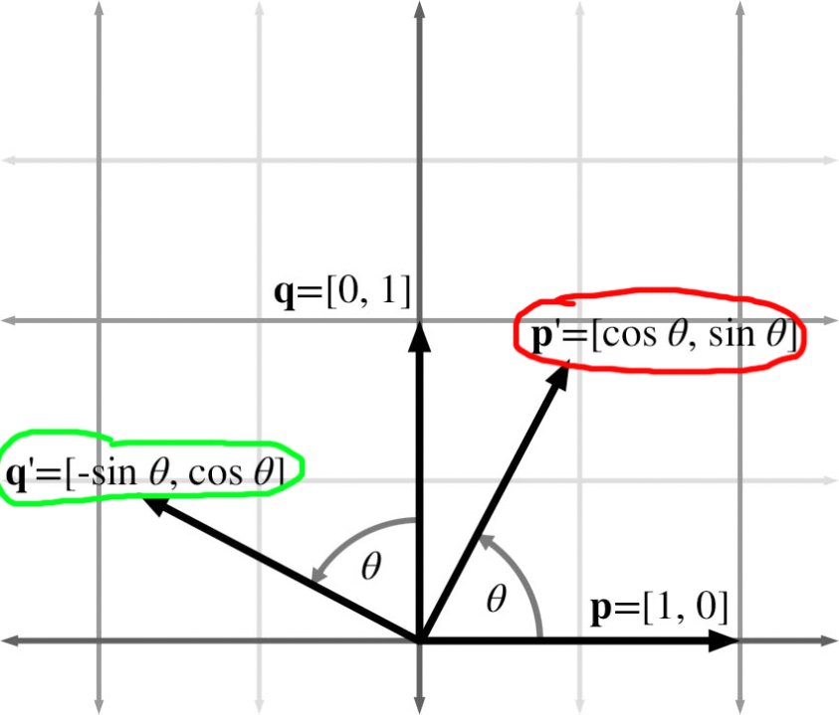
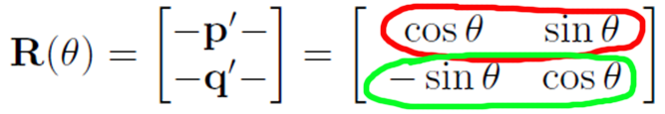
Construct Matrix from Basis Vectors

Slide 9
3D Rotation About Cardinal Axis
In 3D, rotation occurs about an axis rather than a point as in 2D.
The most common type of rotation is a simple rotation about one of the cardinal axes.
We'll need to establish which direction of rotation is “positive” and which is “negative.”
We're going to obey the left-hand rule for this (review Chapter 1).

Slide 10
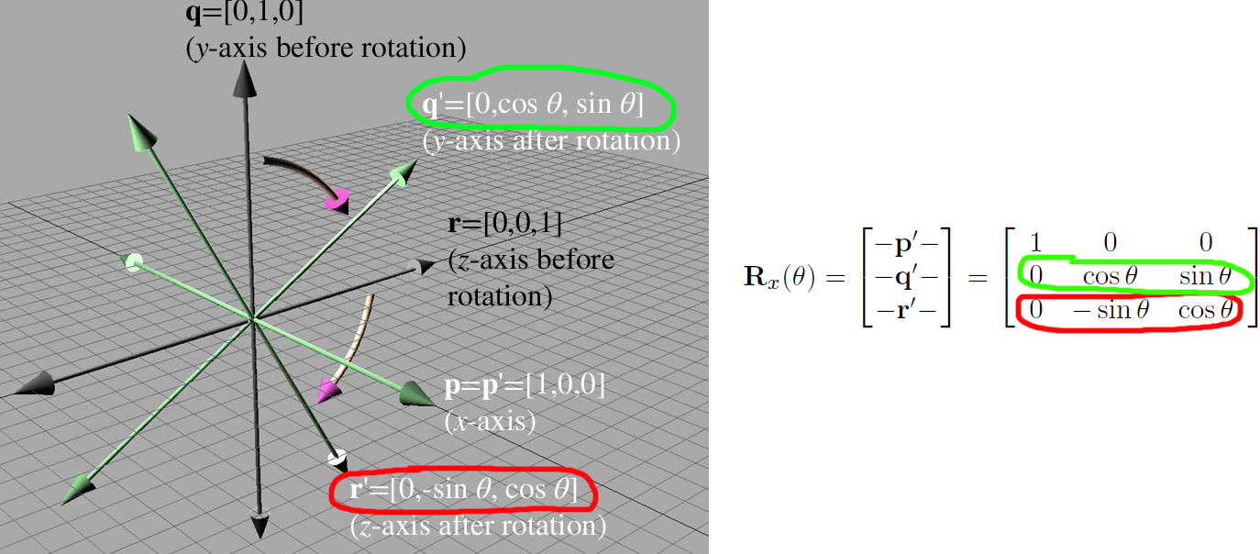
3D Rotate About x-axis

Slide 11
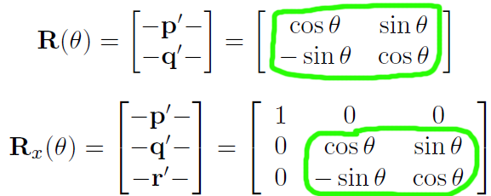
Compare to 2D Case

Slide 12
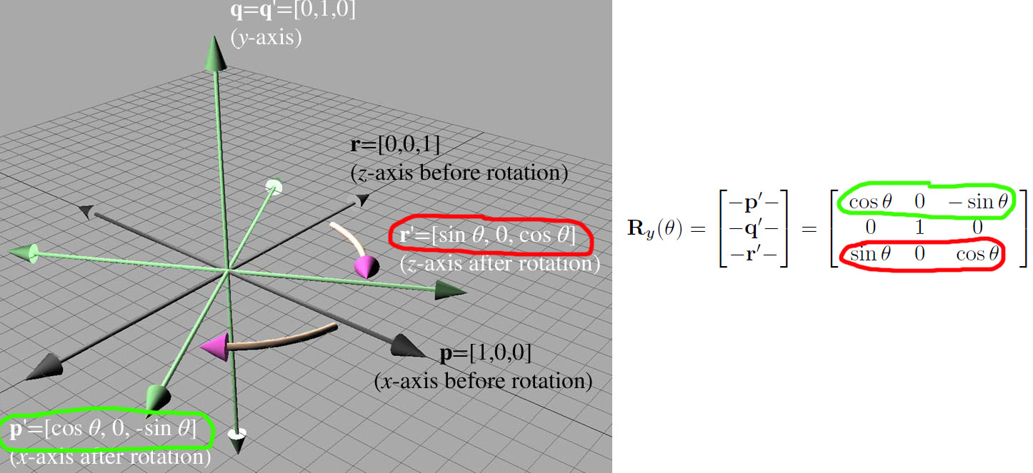
3D Rotate About y-axis

Slide 13
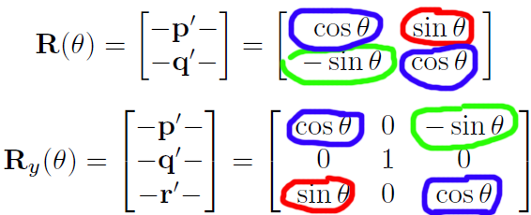
Compare to 2D Case

Slide 14
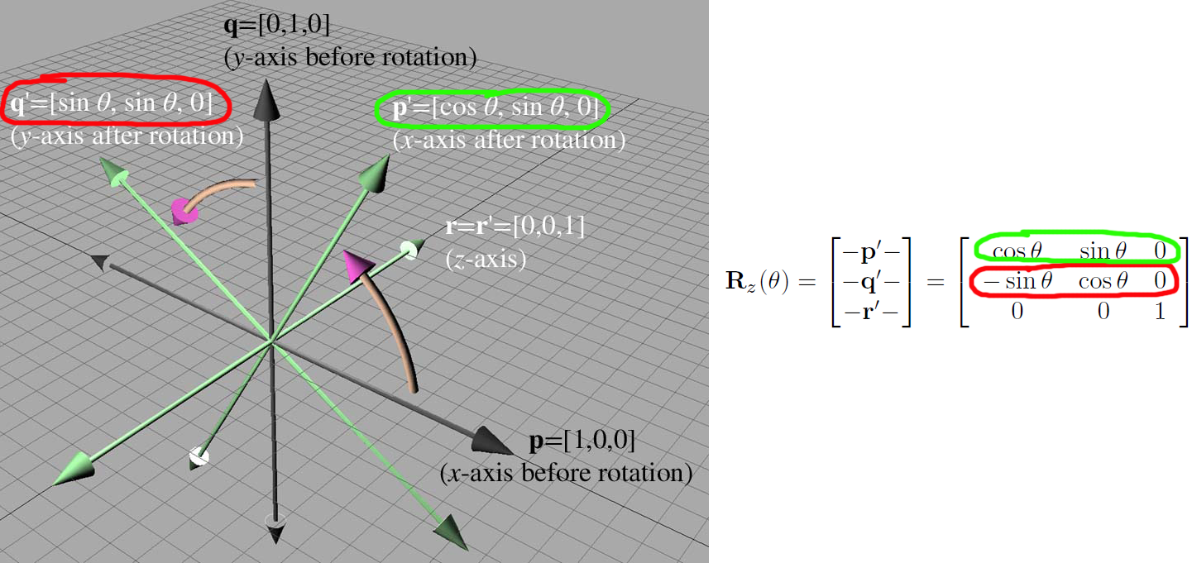
3D Rotate About z-axis

Slide 15
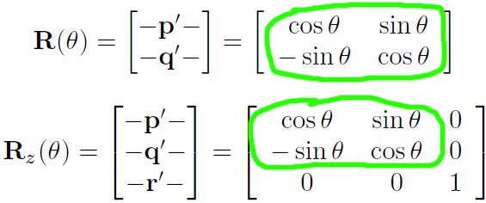
Compare to 2D Case

Slide 16
3D Rotation About Noncardinal Axis
We can also rotate about an arbitrary axis that passes through the origin.
This is more complicated and less common than rotating about a cardinal axis.
Game programmers worry less about this because rotation about an arbitrary axis can be expressed as a sum of rotations about cardinal axes (Euler).
Details are left to the book.

Slide 17
Section 5.2: Scale

Slide 18

Scaling Along Cardinal Axes in 2D

Slide 19
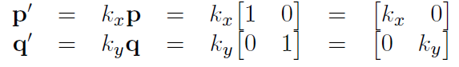
Basis Vectors for Scale
The basis vectors p and q are independently affected by the corresponding scale factors:

Slide 20
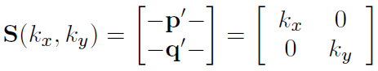
2D Scale Matrix
Constructing the 2D scale matrix S(k_{x}, k_{y}) from these basis vectors:

Slide 21
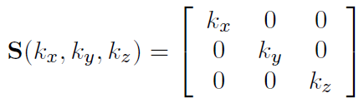
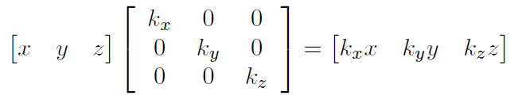
3D Scale Matrix

Slide 22
Scale in Arbitrary Direction
The math for scaling in an arbitrary direction is intricate, but not too tricky.
For game programmers it is not used very often.
Details again left to the book.

Slide 23
Section 5.3: Orthographic Projection

Slide 24

Orthographic Projection

Slide 25
Projecting Onto a Cardinal Axis
Projection onto a cardinal axis or plane most frequently occurs not by actual transformation, but by simply discarding one of the dimensions while assigning the data into a variable of lesser dimension.
For example, we may turn a 3D object into a 2D object by discarding the z components of the points and copying only x and y.
However, we can also project onto a cardinal axis or plane by using a scale value of zero on the perpendicular axis.
For completeness, we present the matrices for these transformations:

Slide 26
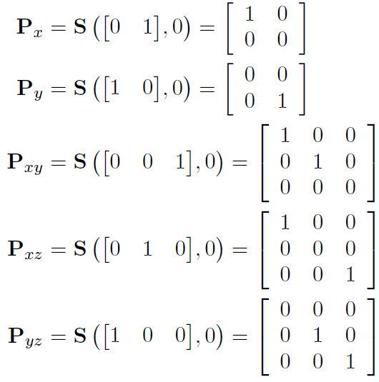

Slide 27
Section 5.4: Reflection

Slide 28
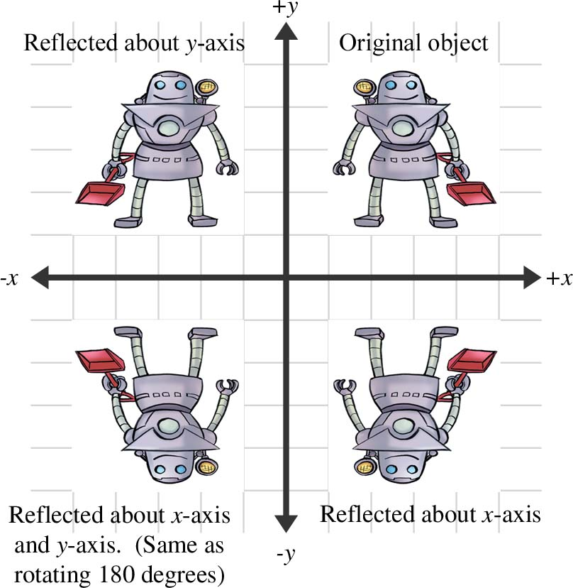
Reflection

Slide 29
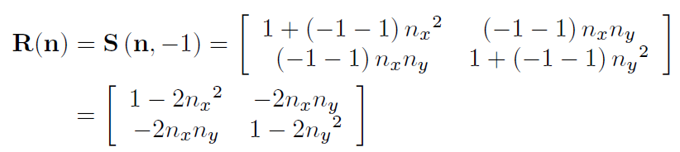
Reflection in 2D
Reflection can be accomplished by applying a scale factor of -1.
Let n be a 2D unit vector. The following matrix performs a reflection about the axis through the origin perpendicular to n:

Slide 30
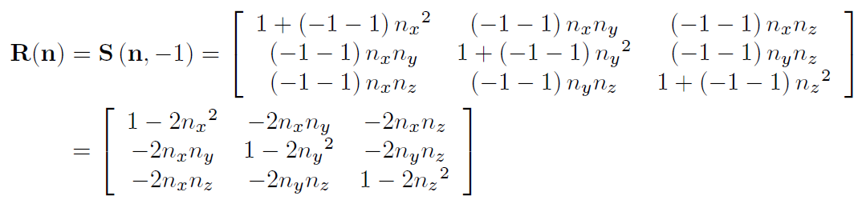
Reflection in 3D
In 3D, we have a reflecting plane instead of an axis. The following matrix reflects about a plane through the origin perpendicular to the unit vector n:

Slide 31
Section 5.5: Shearing

Slide 32


Shearing

Slide 33
Shearing in 2D
Shearing is a transformation that skews the coordinate space, stretching it non-uniformly.
Angles are not preserved; however, surprisingly, areas and volumes are.
The basic idea is to add a multiple of one coordinate to the other.
For example, in 2D, we might take a multiple of y and add it to x, so that x' = x + sy.

Slide 34
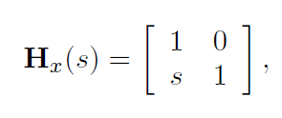
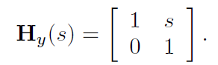
2D Shear Matrices
Let H_{x}(s) be the shear matrix that shears the x coordinate by the other coordinate, y, by amount s.

Slide 35
3D Shear Matrices
In 3D, we can take one coordinate and add different multiples of that coordinate to the other two coordinates.
The notation H_{xy} indicates that the x and y coordinates are shifted by the other coordinate, z.

Slide 36
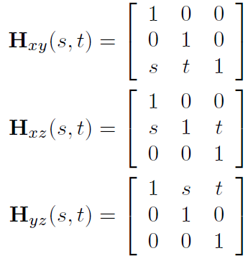
3D Shear Matrices

Slide 37
Section 5.6: Combining Transformations

Slide 38
Combining Transforms
Transformation matrices are combined using matrix multiplication.
One very common example of this is in rendering. Imagine there is an object at an arbitrary position and orientation in the world.
We wish to render this object given a camera in any position and orientation.
To do this, we must take the vertices of the object (assuming we are rendering some sort of triangle mesh) and transform them from object space into world space.
This transform is known as the model transform, which we'll denote M_{obj→wld}
From there, we transform world-space vertices using the view transform, denoted M_{wld→cam} into camera space.
The math involved is summarized on the next slide:

Slide 39
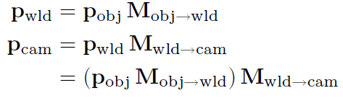
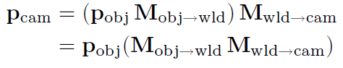
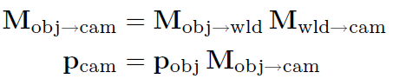
Render Matrix Example
Since matrix multiplication is associative,
Thus we can concatenate the matrices outside the loop, and only have one matrix multiplication inside the loop (remember there are many vertices):

Slide 40
Geometric Interpretation
So we see that matrix concatenation works from an algebraic perspective using the associative property of matrix multiplication.
Let's see if we can't get a more geometric interpretation.
Recall that that the rows of a matrix contain the basis vectors after transformation. This is true even in the case of multiple transformations.
Notice that in the matrix product AB, each resulting row is the product of the corresponding row from A times the matrix B.
Let the row vectors a₁, a₂, and a₃ stand for the rows of A.
Then matrix multiplication can alternatively be written like this…

Slide 41
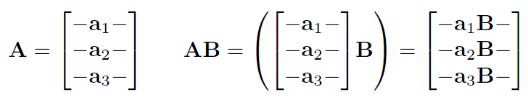
Geometric Interpretation
This makes it explicitly clear that the rows of the product of AB are actually the result of transforming the basis vectors in A by B.

Slide 42
Classes of Transformations
Linear transformations
Affine transformations
Invertible transformations
Angle preserving transformations
Orthogonal transformations
Rigid body transformations

Slide 43
Disclaimer
When we discuss transformations in general, we make use of the synonymous terms mapping or function.
In the most general sense, a mapping is simply a rule that takes an input and produces an output. We denote that the mapping F maps a to b by writing F(a) = b. (Read “F of a equals b.”)
We are mostly interested in the transformations that can be expressed as matrix multiplication, but others are possible.
In this section we use the determinant of a matrix. We're getting a bit ahead of ourselves, since we won't give a full explanation of determinants until Chapter 6.
So for now, just know that that the determinant of a matrix is a scalar quantity that is very useful for making certain high-level, shall we say, determinations about the matrix. ☺

Slide 44
Section 5.7: Classes of Transformations

Slide 45
Linear Transformations
A mapping F(a) is linear if F(a + b) = F(a) + F(b) and F(ka) = kF(a).
The mapping F(a) = aM, where M is any square matrix, is a linear transformation, because matrix multiplication satisfies the equations in the first bullet point of this slide:
F(a + b) = (a + b)M = aM + bM = F(a) + F(b)
F(ka) = (ka)M = k(aM) = kF(a)

Slide 46
The Zero Vector
Any linear transformation will transform the zero vector into the zero vector.
If F(0) = a and a ≠ 0, then F cannot be a linear transformation, since F(k0) = a and therefore F(k0) ≠ kF(0).
Therefore:
Any transformation that can be accomplished with matrix multiplication is a linear transformation.
Linear transformations do not include translation.

Slide 47
Caveats
In some literature, a linear transformation is defined as one in which parallel lines remain parallel after transformation.
This is almost completely accurate, with two exceptions.
First, parallel lines remain parallel after translation, but translation is not a linear transformation.
Second, what about projection? When a line is projected and becomes a single point, can we consider that point parallel to anything?
Excluding these technicalities, the intuition is correct: a linear transformation may stretch things, but straight lines are not warped and parallel lines remain parallel.

Slide 48
Affine Transformations
An affine transformation is a linear transformation followed by translation.
Thus, the set of affine transformations is a superset of the set of linear transformations: any linear transformation is an affine translation, but not all affine transformations are linear transformations.
Since all of the transformations we discussed so far in this chapter are linear transformations, they are all also affine transformations. (Though none of them have a translation portion.)
Any transformation of the form v' = vM + b is an affine transformation.

Slide 49
Invertible Transformations
A transformation is invertible if there exists an opposite transformation, known as the inverse of F, that undoes the original transformation.
In other words, a mapping F(a) is invertible if there exists an inverse mapping F⁻¹ such that for all a, F⁻¹(F(a)) = F(F⁻¹(a)) = a.
This implies that F⁻¹ is also invertible.
There are non-affine invertible transformations, but we will not consider them for the moment.

Slide 50
Are All Affine Transforms Invertible?
An affine transformation is a linear transformation followed by a translation.
Obviously, we can always undo the translation portion by simply translating by the opposite amount.
So the question becomes whether or not the linear transformation is invertible.

Slide 51
Are All Linear Transforms Invertible?
Intuitively, we know that all of the transformations other than projection can be undone – if we rotate, scale, reflect, or skew, we can always unrotate, unscale, unreflect, or unskew.
But when an object is projected, we effectively discard one or more dimensions‘ worth of information, and this information cannot be recovered.
Thus all of the primitive transformations other than projection are invertible.

Slide 52
Are All Matrices Invertible? No.
Since any linear transformation can be expressed as multiplication by a matrix, finding the inverse of a linear transformation is equivalent to finding the inverse of a matrix.
We will discuss how to do this in Chapter 6. If the matrix has no inverse, we say that it is singular, and the transformation is non-invertible.
We can use a value called the determinant to determine whether a matrix is invertible.
The determinant of an invertible matrix is nonzero.
The determinant of a non-invertible matrix is zero.

Slide 53
Singularity and Square Matrices
When a square matrix is singular, its basis vectors are not linearly independent.
If the basis vectors are linearly independent, then it they have full rank, and coordinates of any given vector in the span are uniquely determined.
If the vectors are linearly independent, then there is a portion of the space that is not in the span of the basis.
This is known as the null space of the matrix.
If we transform vectors in the null space using the matrix, many vectors will be projected into the same vector in the span of the basis, and we won't have any way to differentiate them.

Slide 54
Angle Preserving Transformations
A transformation is angle-preserving if the angle between two vectors is not altered in either magnitude or direction after transformation.
Only translation, rotation, and uniform scale are angle-preserving transformations.
An angle-preserving matrix preserves proportions.
We do not consider reflection an angle-preserving transformation because even though the magnitude of angle between two vectors is the same after transformation, the direction of angle may be inverted.
All angle-preserving transformations are affine and invertible.

Slide 55
Orthogonal Transformations
Orthogonal is a term that describes a matrix whose rows form an orthonormal basis – the axes are perpendicular to each other and have unit length.
Orthogonal transformations are interesting because it is easy to compute their inverse, and they arise frequently in practice.
We will talk more about orthogonal matrices in Chapter 6.
Translation, rotation, and reflection are the only orthogonal transformations.
Orthogonal matrices preserve the magnitudes of angles, areas, and volumes, but possibly not the signs.
The determinant of an orthogonal matrix is 1.
All orthogonal transformations are affine and invertible.

Slide 56
Rigid Body Transformations
A rigid body transformation is one that changes the location and orientation of an object, but not its shape.
All angles, lengths, areas, and volumes are preserved.
Translation and rotation are the only rigid body transformations.
Reflection is not considered a rigid body transformation.
Rigid body transformations are also known as proper transformations.
All rigid body transformations are orthogonal, angle-preserving, invertible, and affine.
Rigid body transforms are the most restrictive class of transforms discussed in this section, but they are also extremely common in practice.
The determinant of a rigid body transformation matrix is 1.

Slide 57
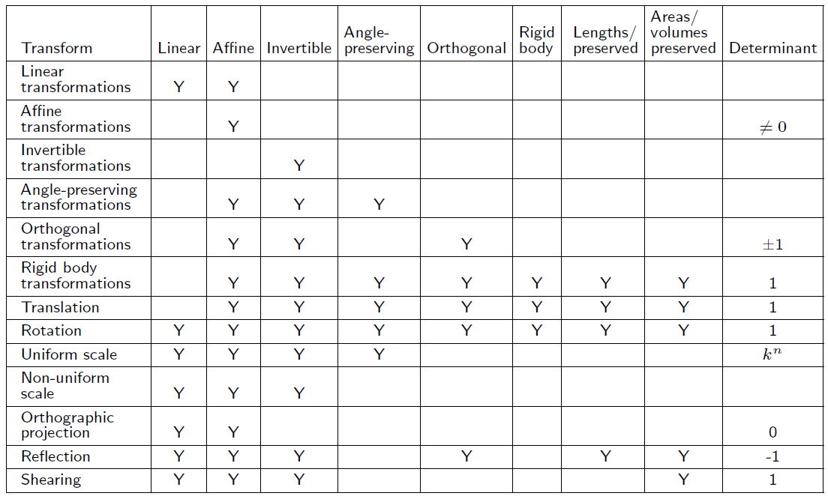
Transformation Summary

Slide 58
Next
That concludes Chapter 5: Matrices and Linear Transformations.
Next will be Chapter 6: More on Matrices.

Slide 59
That concludes Chapter 5. Next, Chapter 6: More on Matrices

